Slide 1


Exposure CS 2020
for CS1
Chapter 3 Section 5-7 Slides
Syntax Errors, Issues with Quotes &
The Responsible Use of Computers
PowerPoint Presentation
created by:
Mr. John L. M. Schram
and Mr. Leon Schram
Authors of Exposure
Computer Science

Slide 2
Section 3.5
Syntax Errors

Slide 3
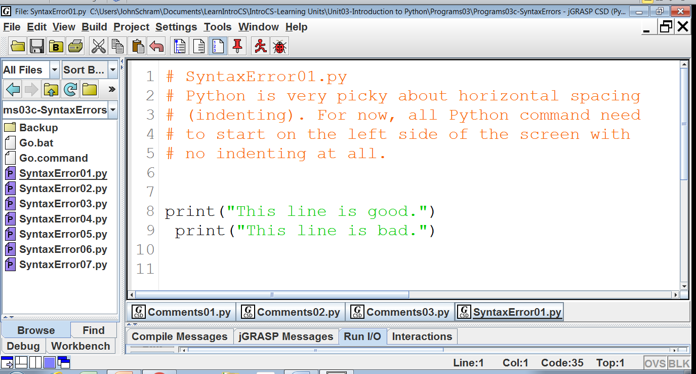

Slide 4
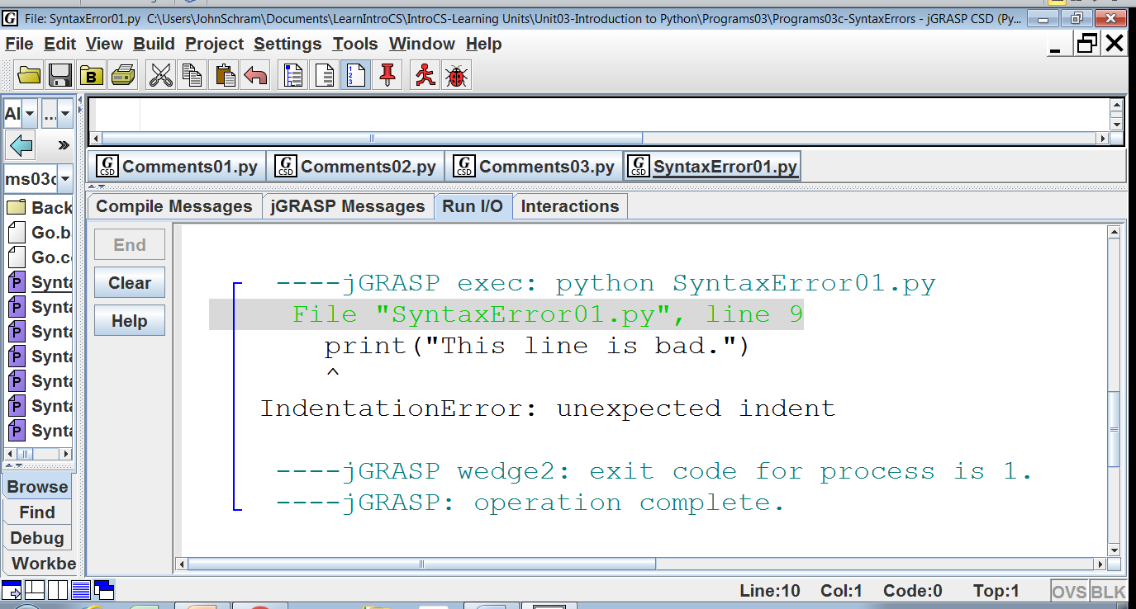

Slide 5
NOTE: The error message
indicates what the error is
and where it was found.

Slide 6
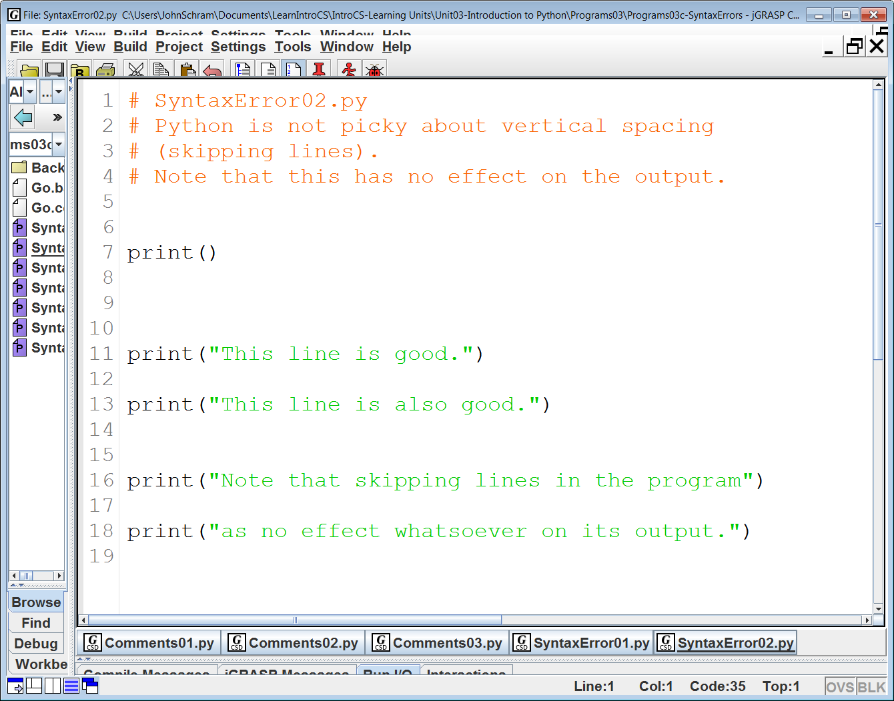

Slide 7
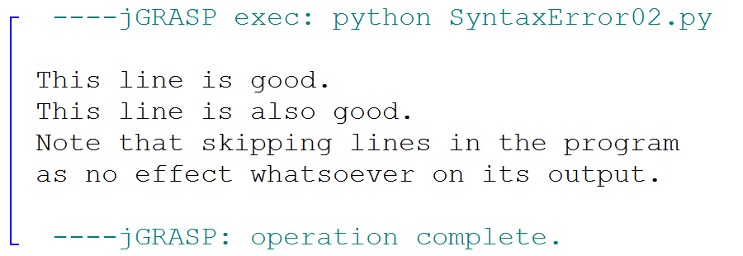

Slide 8
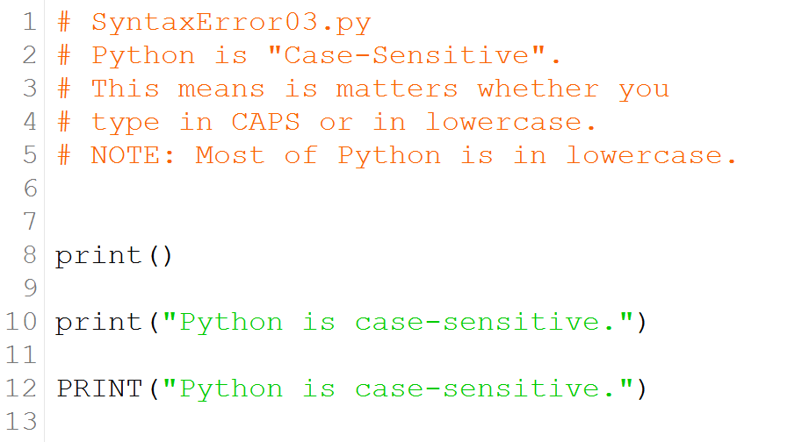

Slide 9
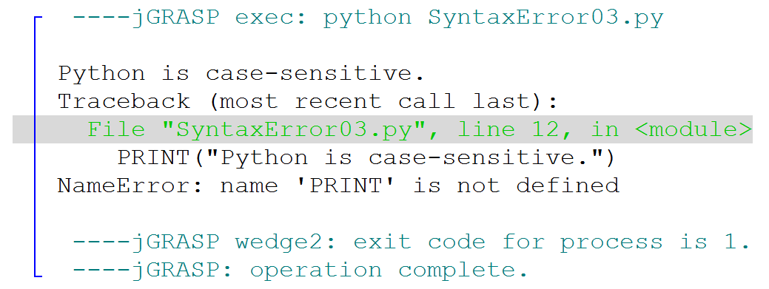

Slide 10
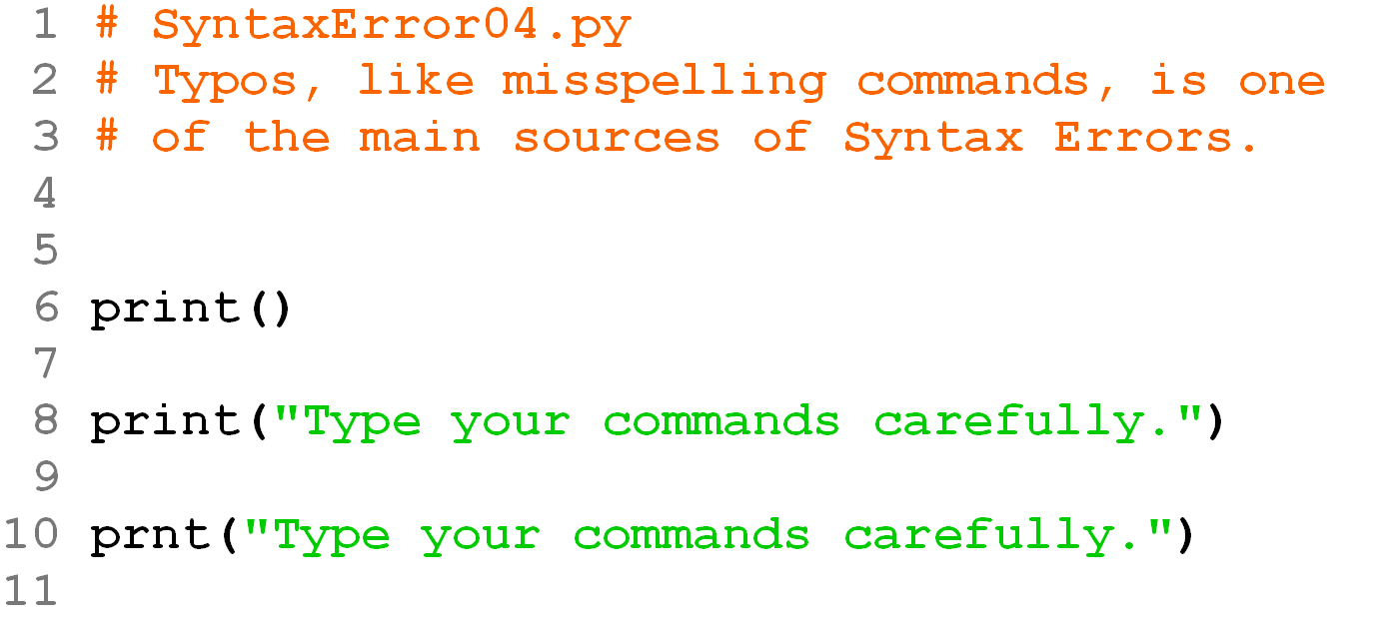

Slide 11
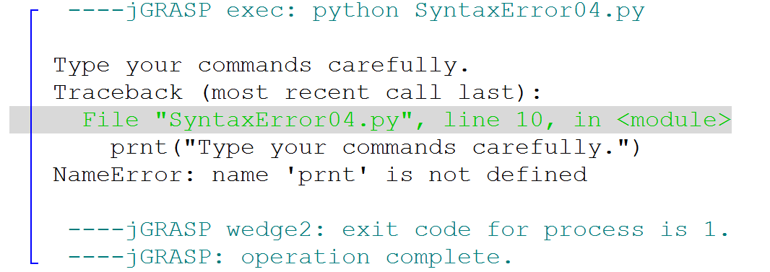

Slide 12
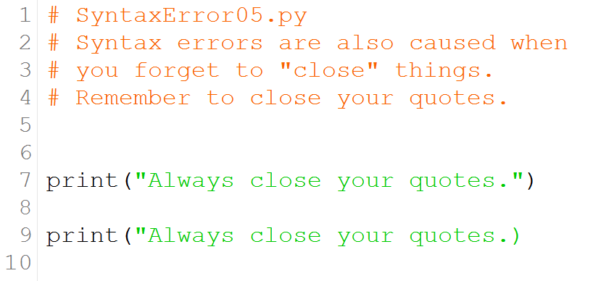

Slide 13
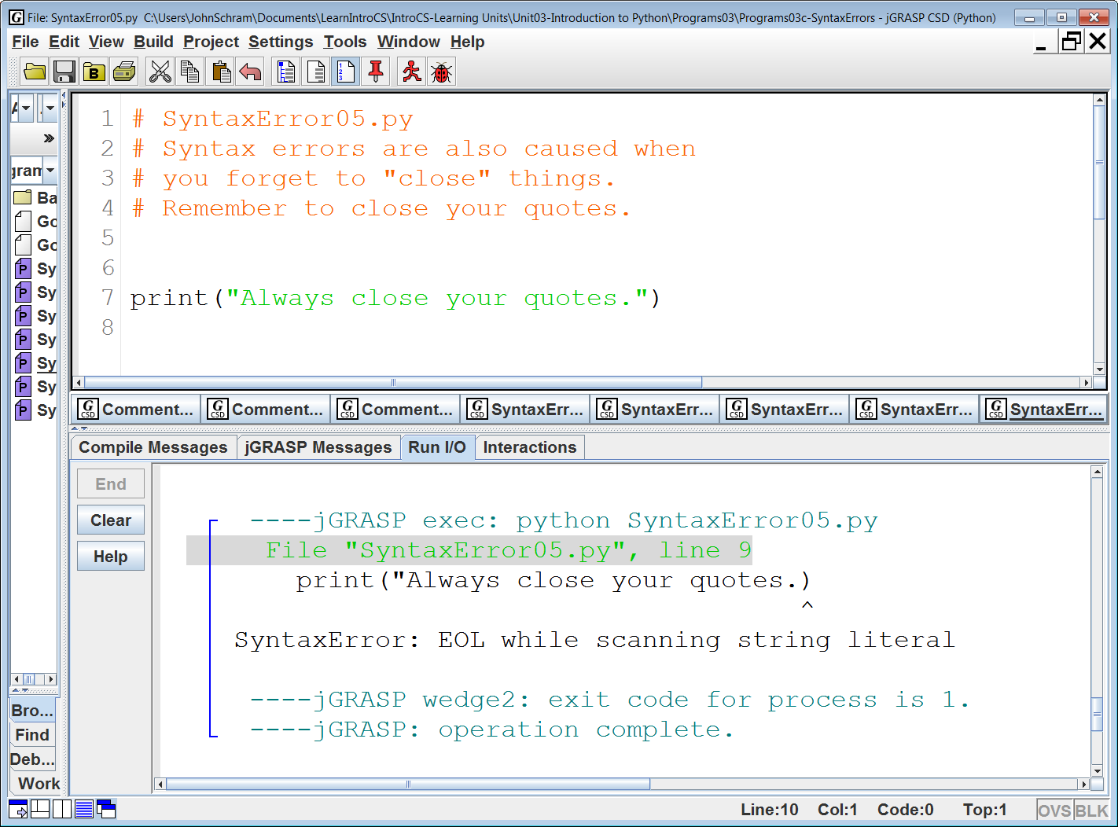

Slide 14
“End Of Line”

Slide 15
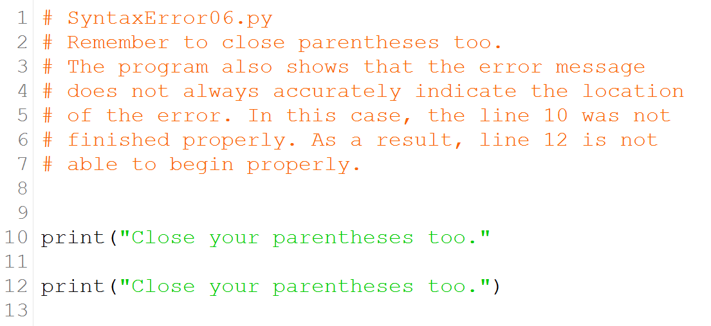

Slide 16
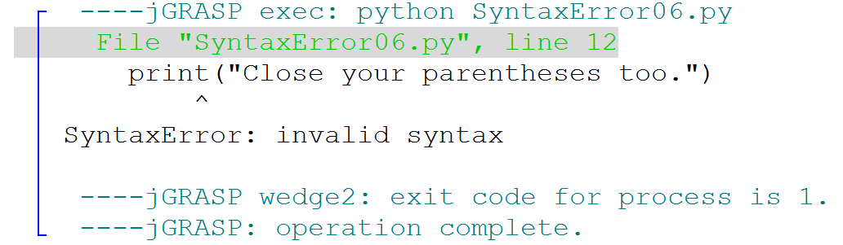

Slide 17
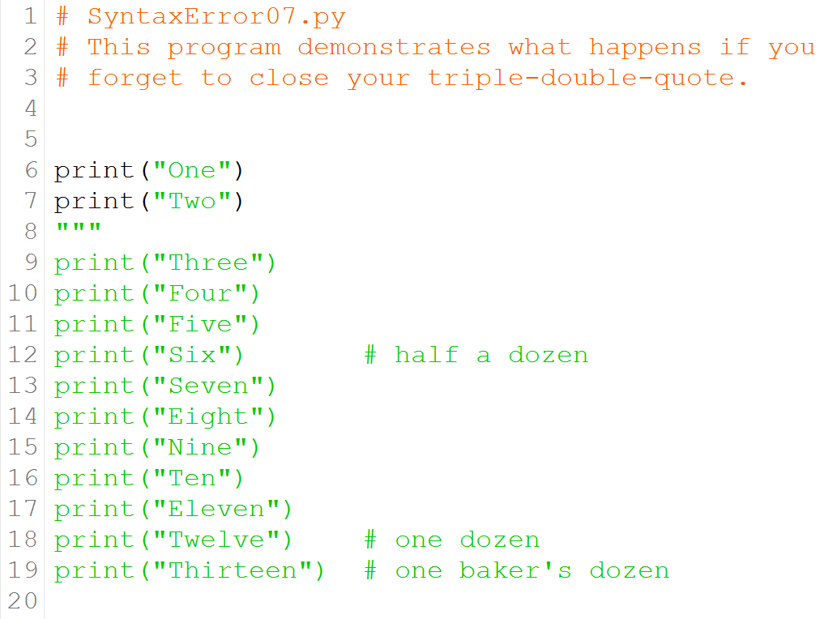

Slide 18
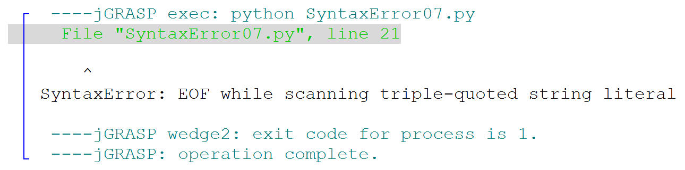

Slide 19
“End Of File”

Slide 20
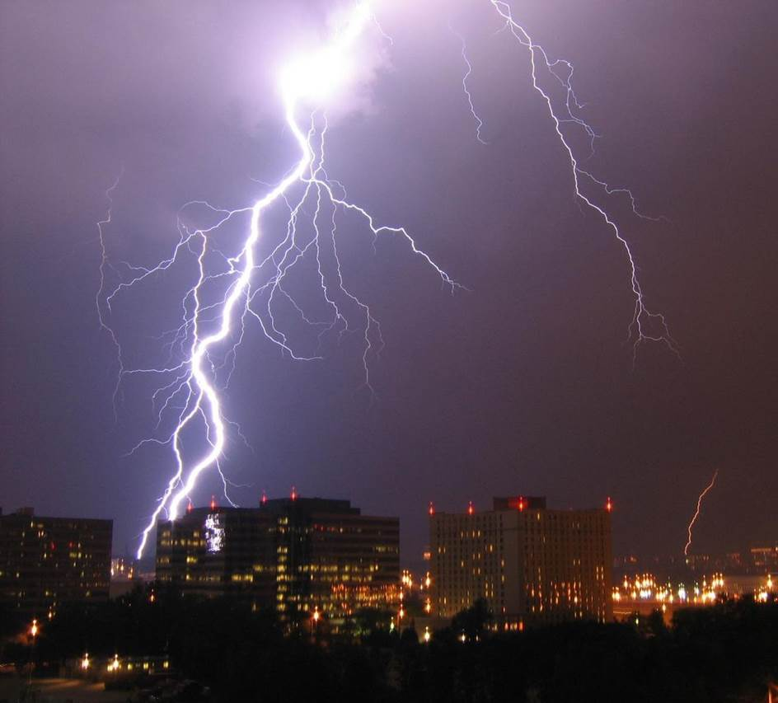
Computer Science
Commandment
Anything that thou open,
thou shalt also close!

Slide 21
Section 3.6
The Issue with Quotes

Slide 22
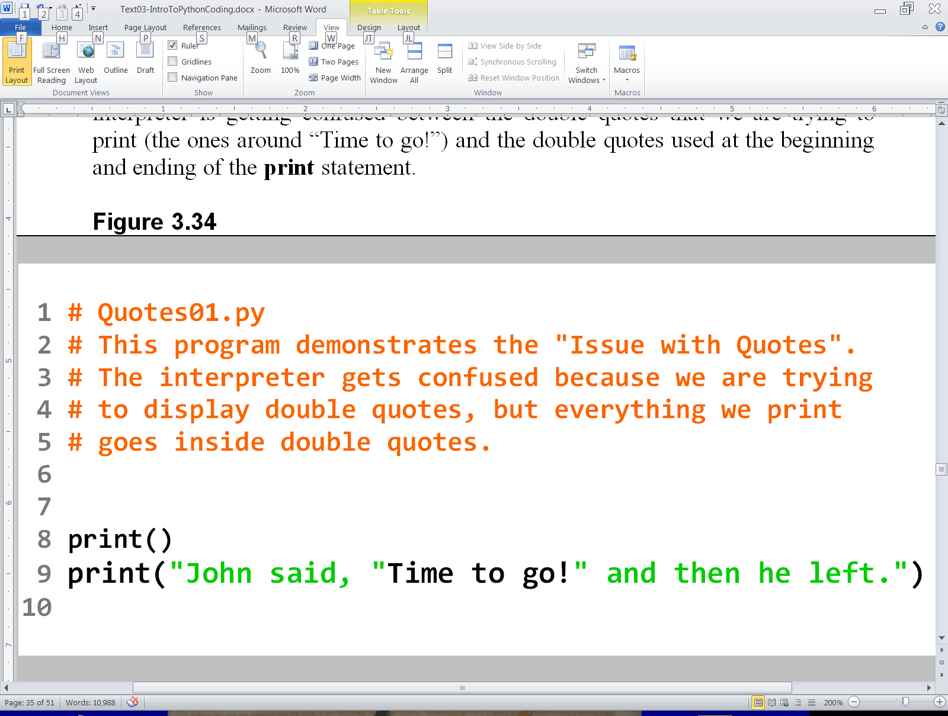
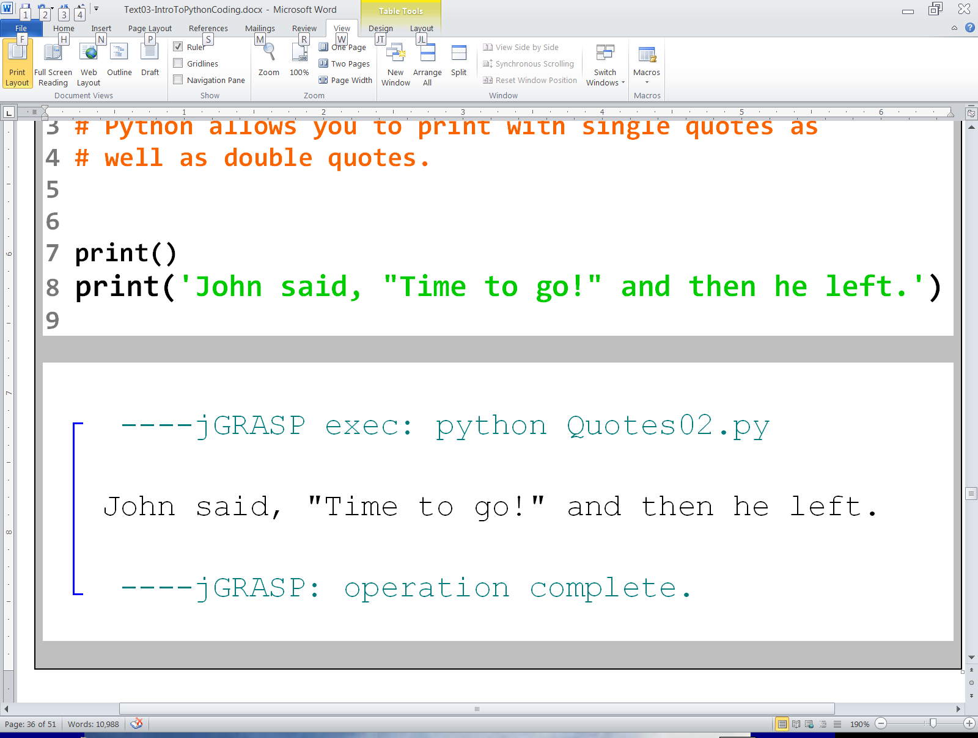
This is the sentence that I wish to display:

Slide 23
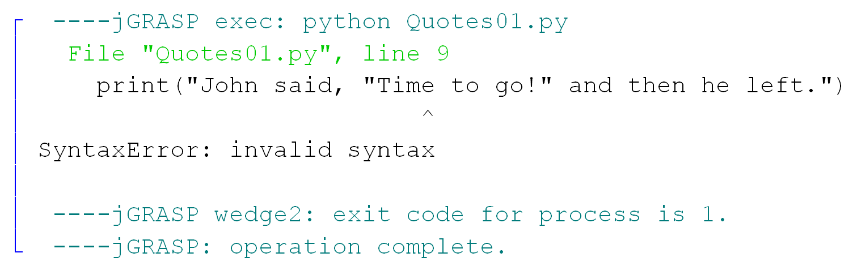

Slide 24
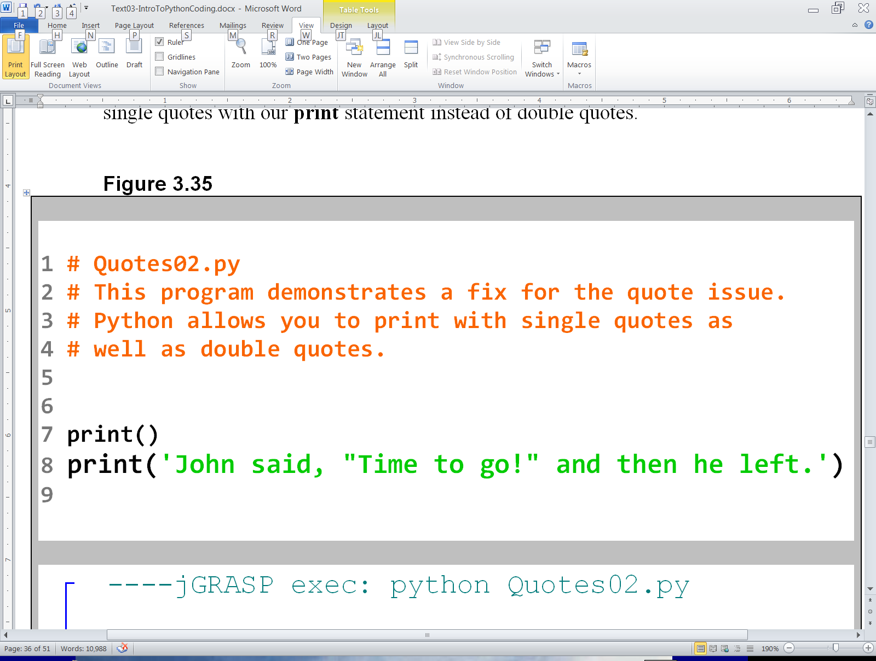

Slide 25
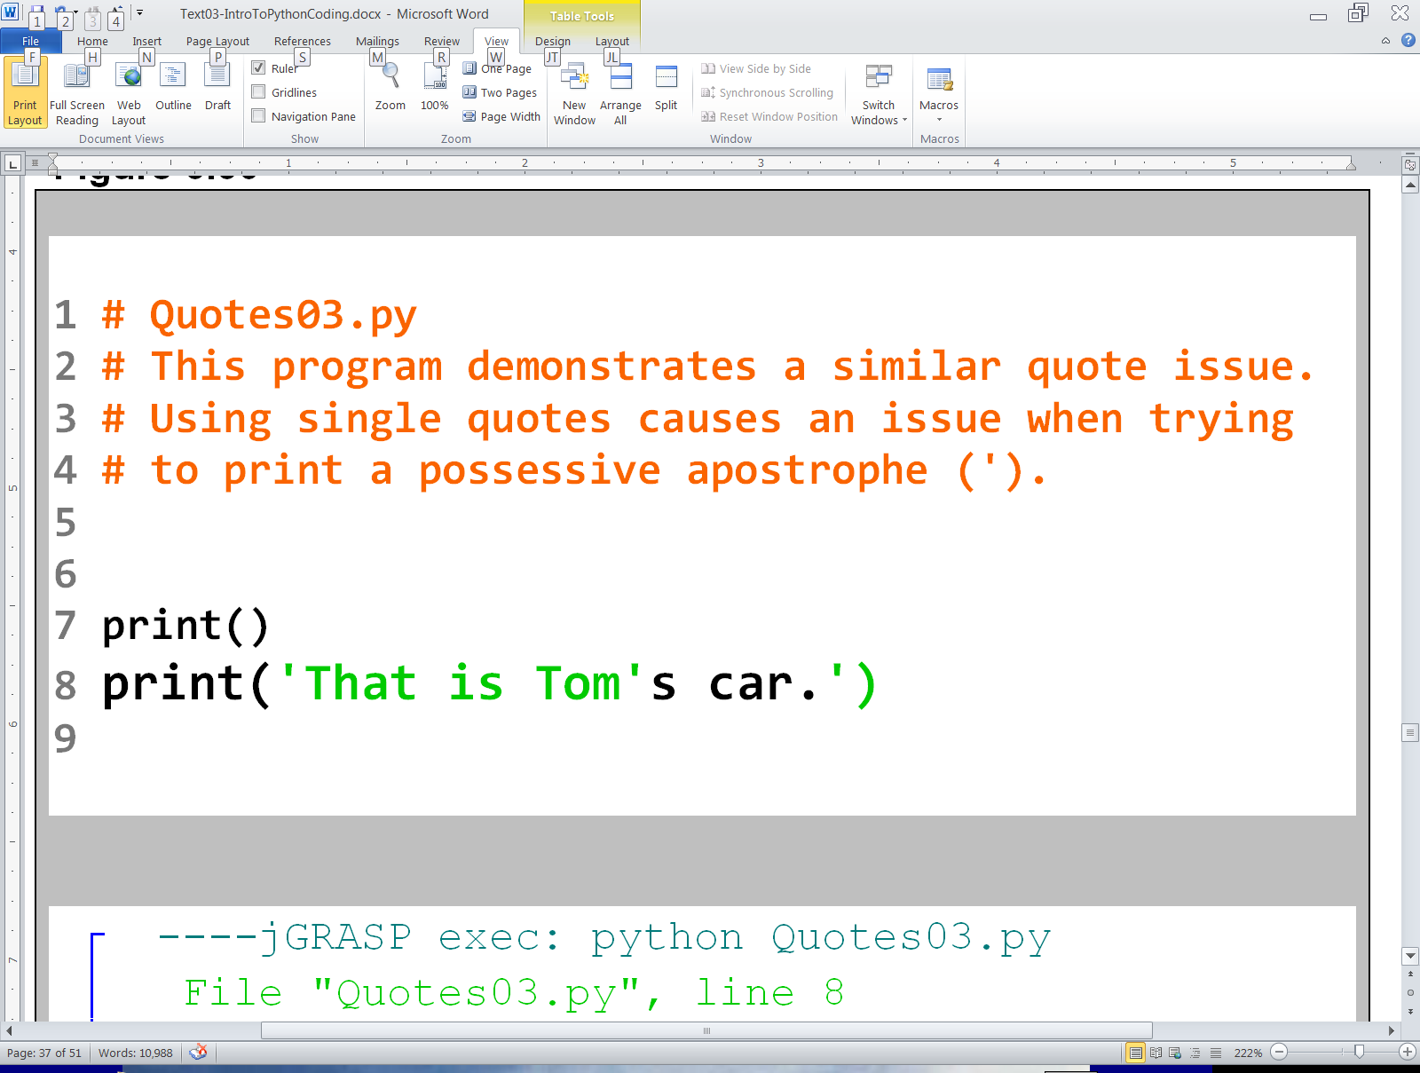
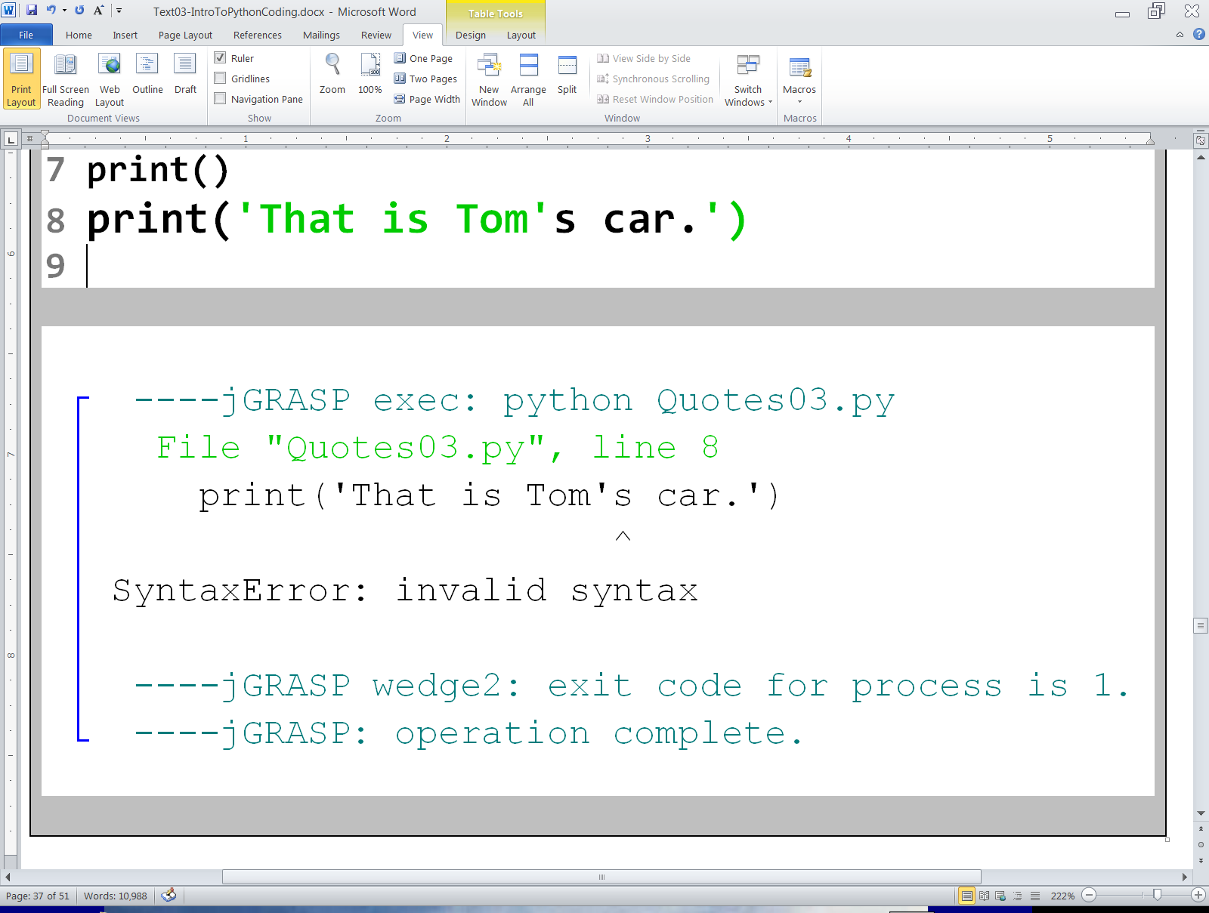

Slide 26
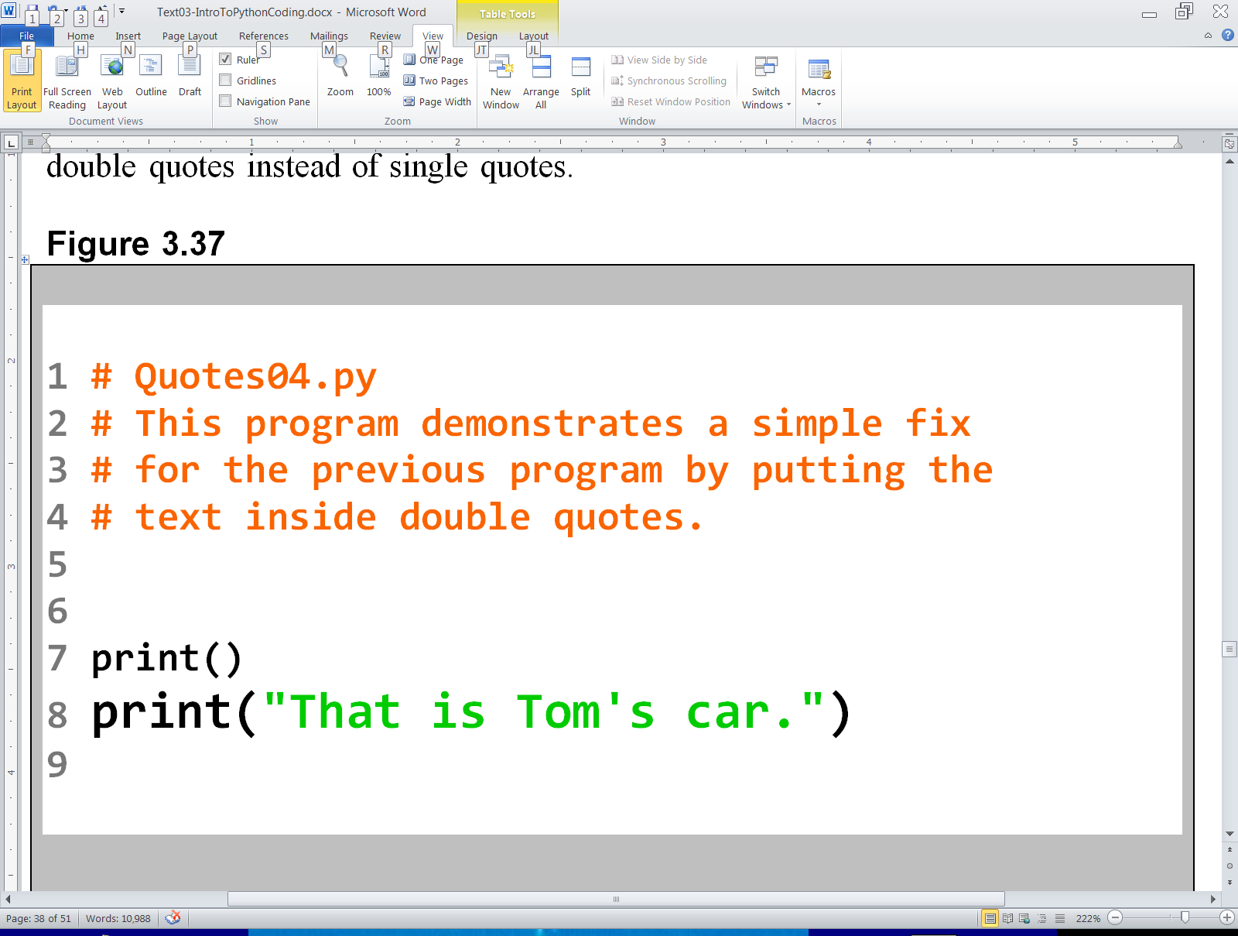
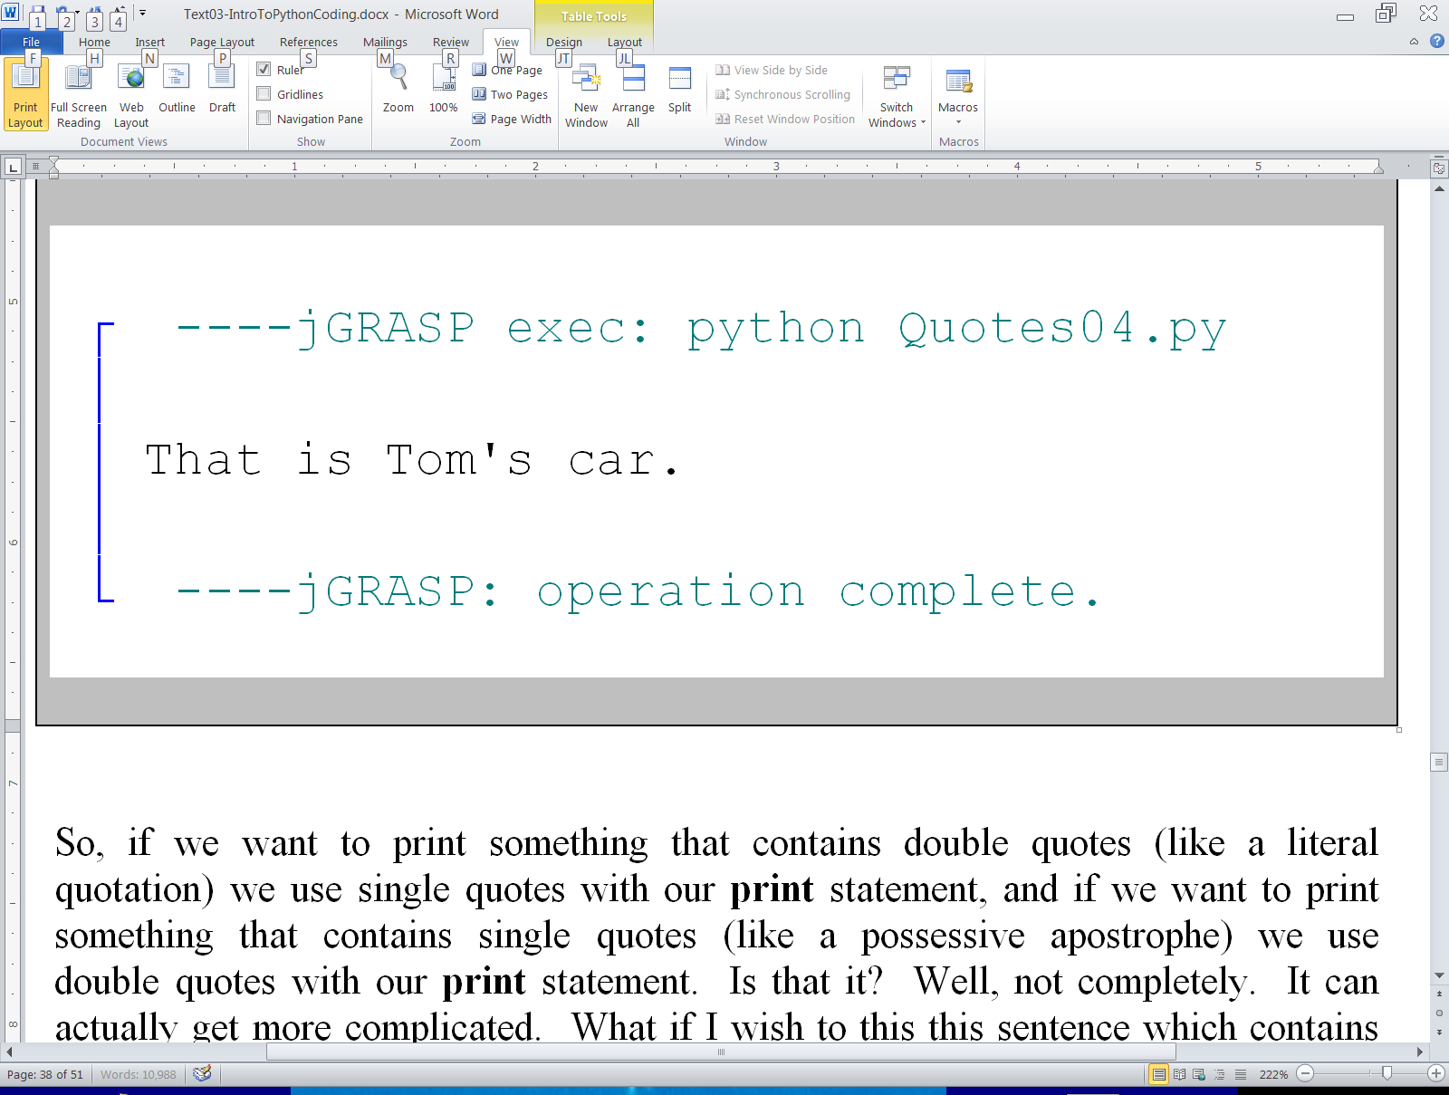

Slide 27
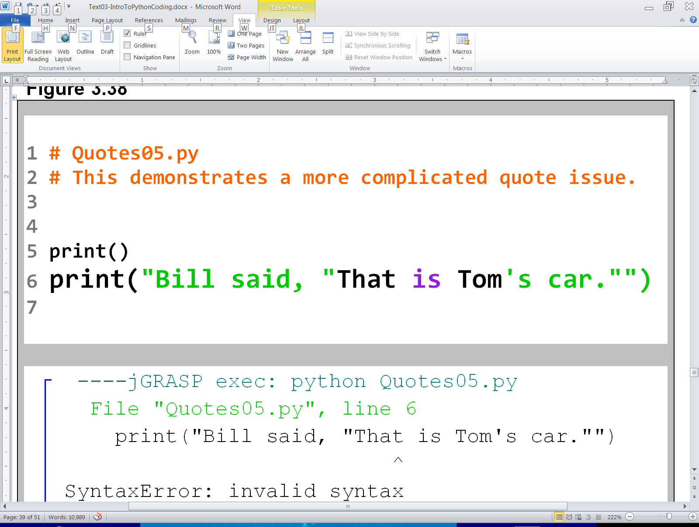
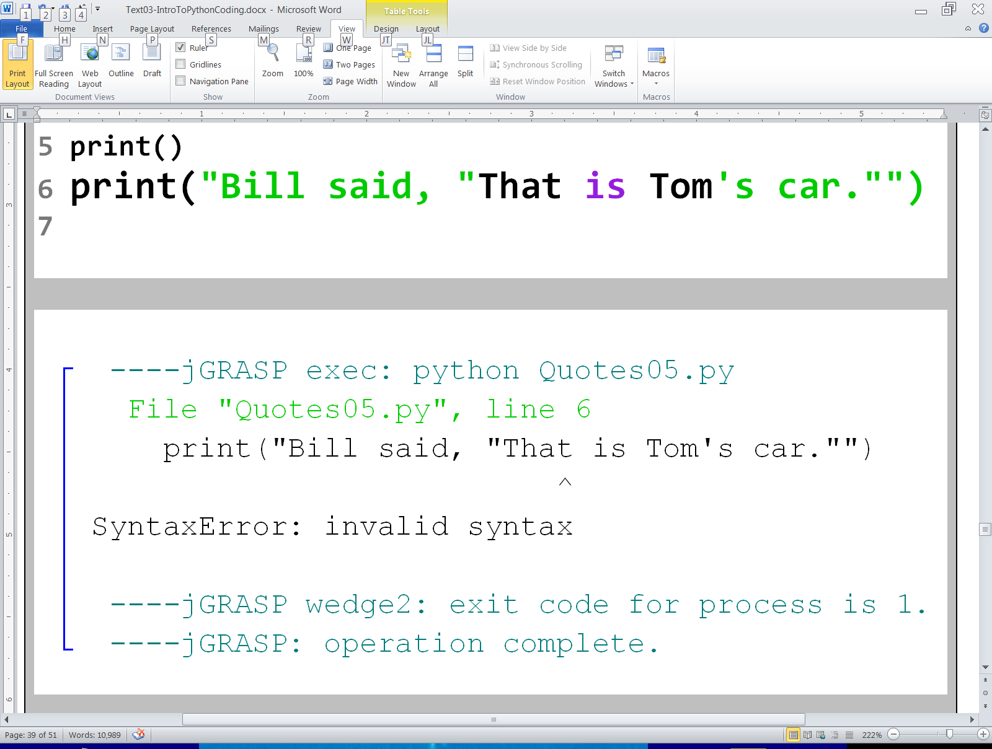

Slide 28
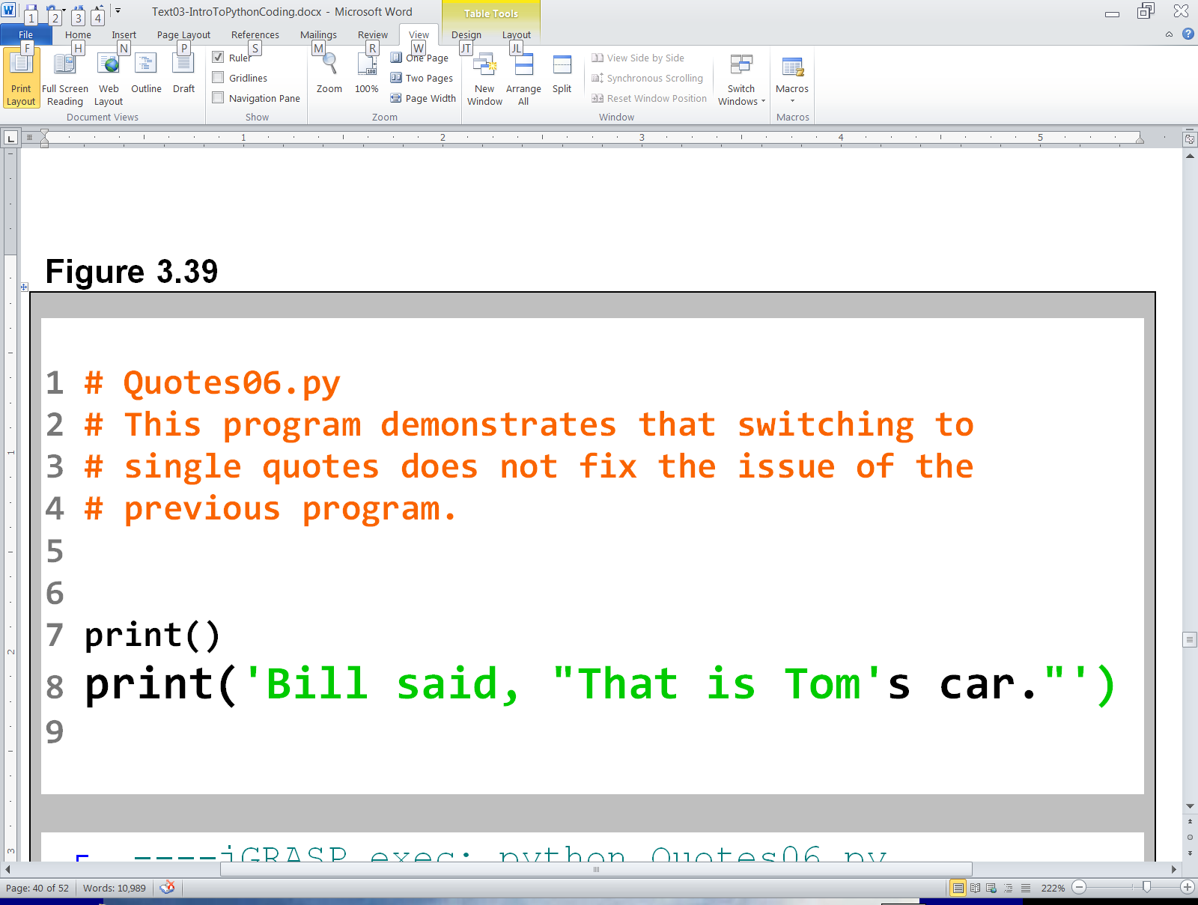
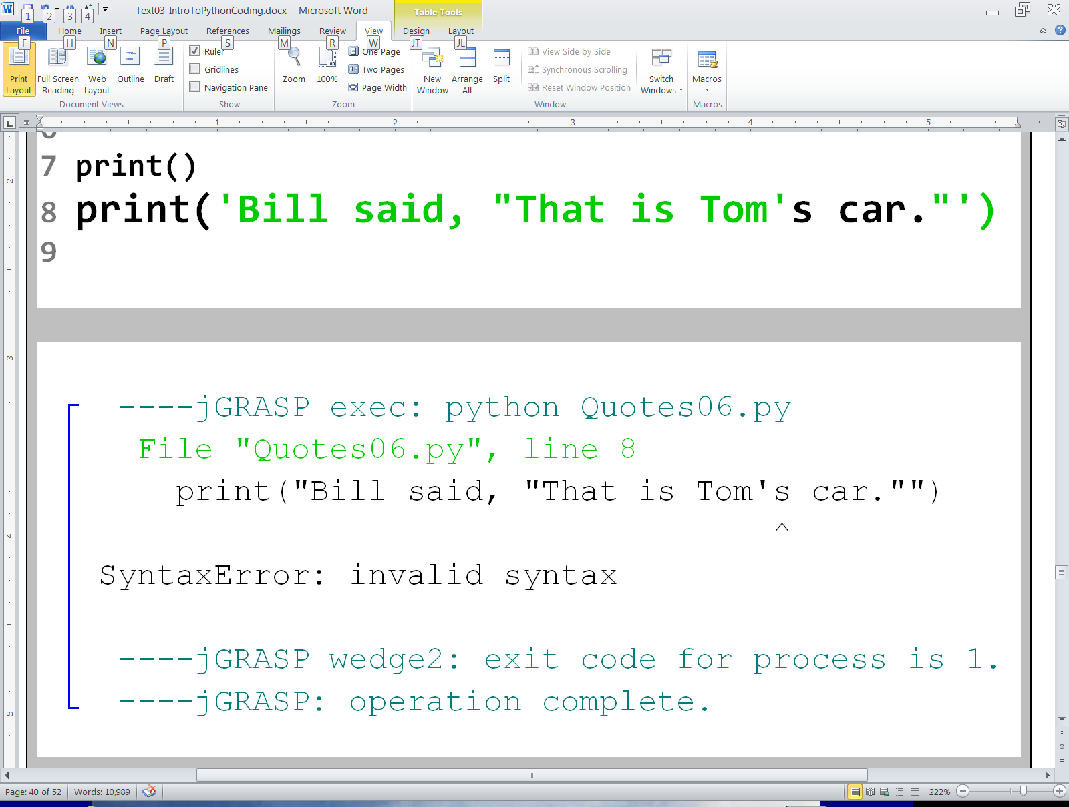

Slide 29
More Escape
Sequences

Slide 30
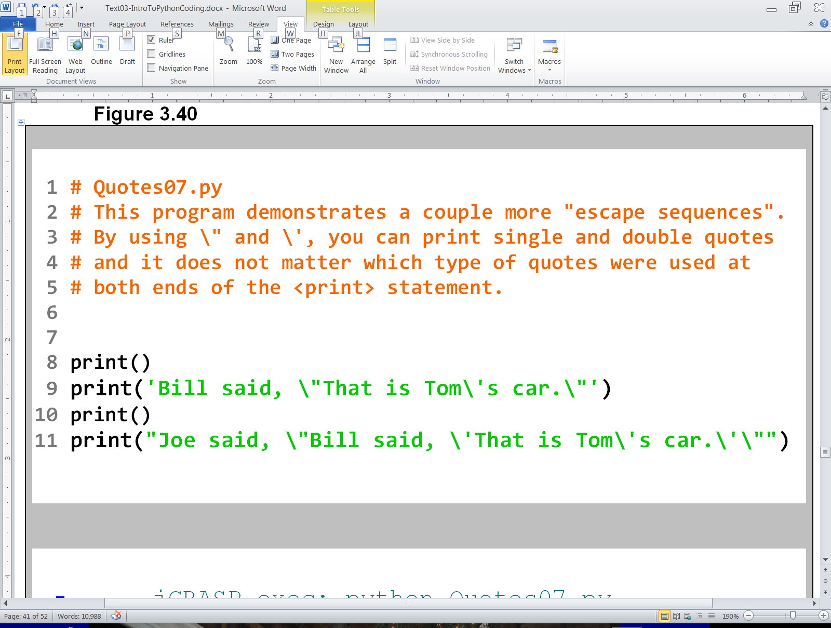
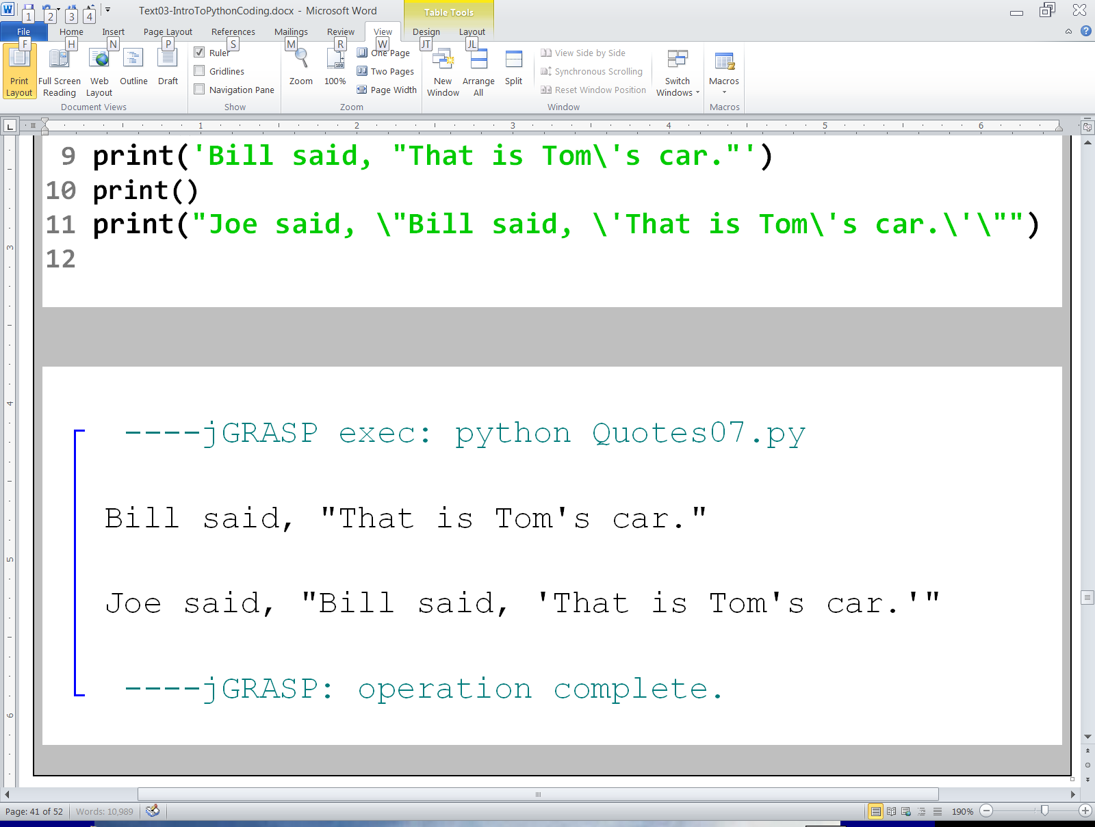

Slide 31
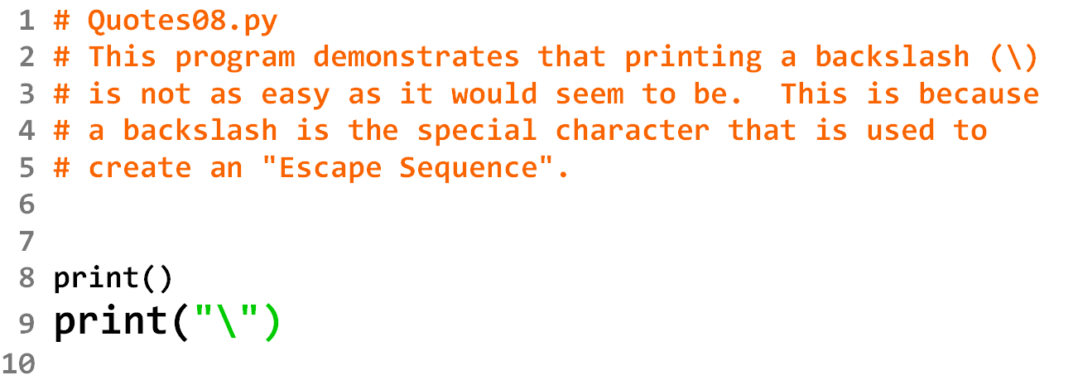

Slide 32
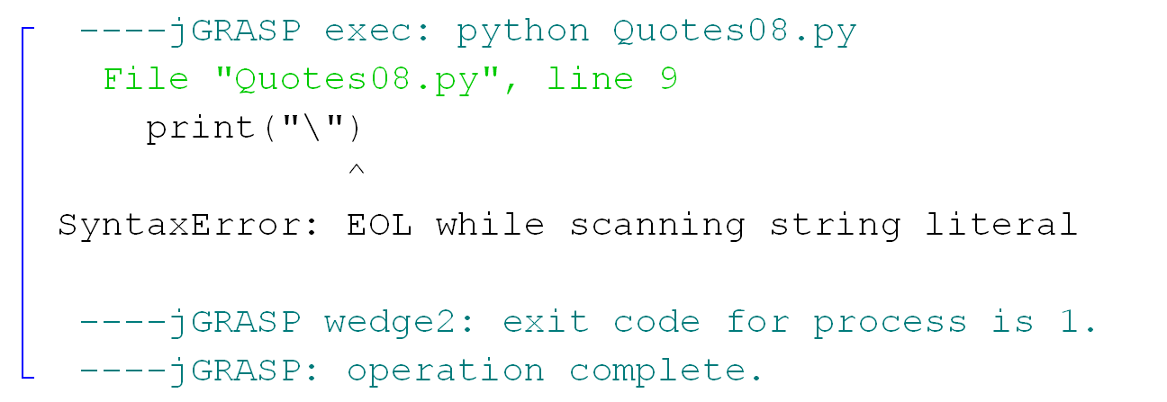

Slide 33
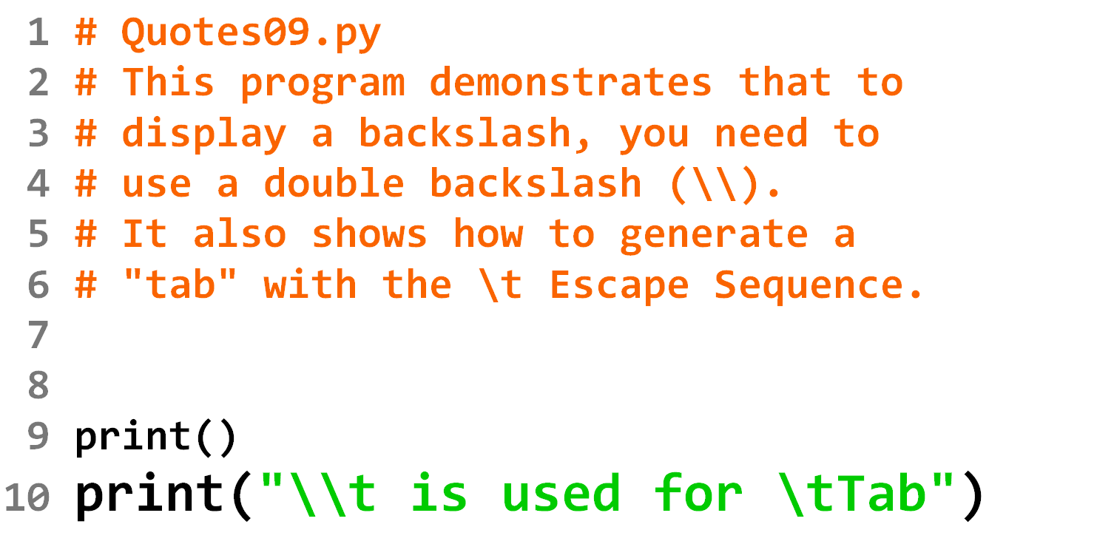

Slide 34
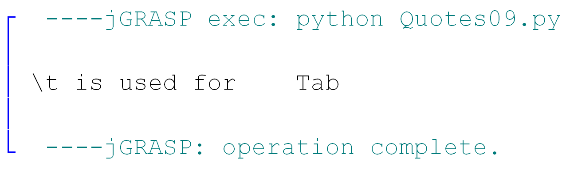

Slide 35
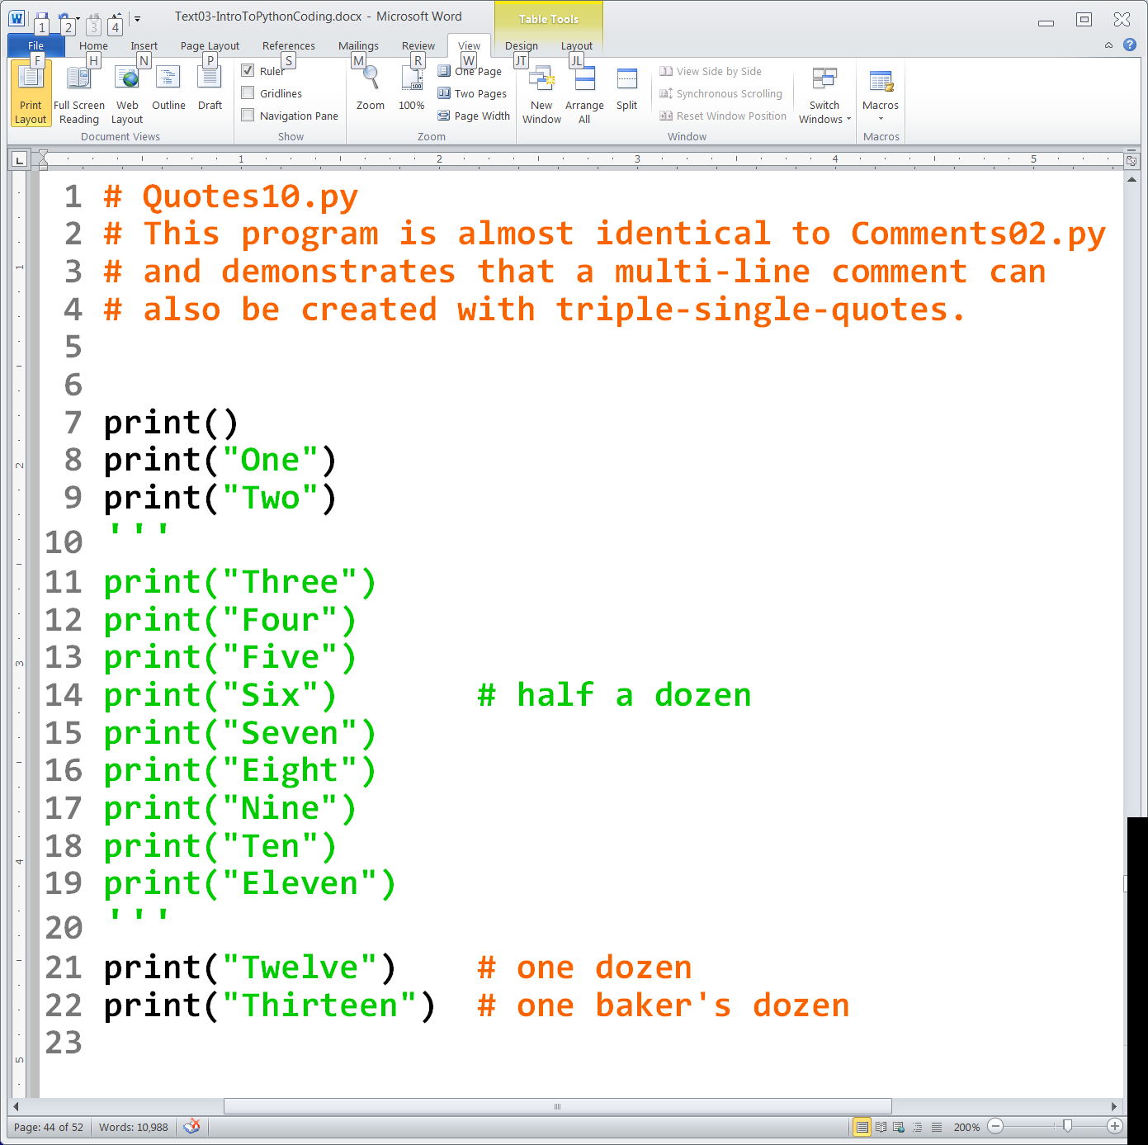
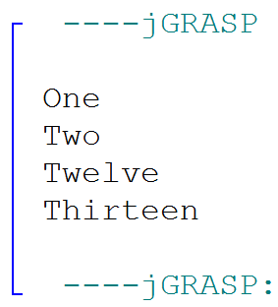

Slide 36
Section 3.7
The Responsible Use
of Computers

Slide 37

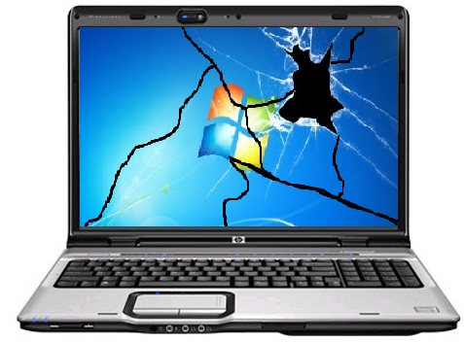



Protect Your Computer From the Environment
Computers and computer information are vulnerable.
Computers can be physically damaged.
RAM is temporary, save often!
CDs, USB Drives and even hard drives can go bad.
Back up your stuff!
Blackouts and Power Surges
are major problems.
Backup Batteries and
Surge Protectors are useful.

Slide 38
Protect Your Computer From Viruses
A virus is a special program that has these two qualities:
The ability to duplicate itself
to spread to other systems.
The payload it carries, which is a program
that will do some type harm to the computer.

Slide 39

Protect Your Computer From Improper Access
Don't leave your computer unattended and
logged in.
Information can easily be copied or erased
from an unattended computer.
Unattended laptops are easily stolen.
Label and guard your stuff!

Slide 40

The Ethical Use of Computer Software
Copying copyrighted software is illegal.
Companies have been sued and people have been arrested for not taking this seriously.

Slide 41
Hacking
Some confused people think that if you hack into a network, it is fine as long as you don't steal any money or damage any information.
Just attempting to hack into a computer
or network is a misdemeanor.
If you actually succeed at getting in,
you have already committed a felony.
Yes, high school students
have been prosecuted for this!
WRONG!

Slide 42
Vandalism
Physical computer vandalism is bad, but typically not a problem in high school.
You also need to make sure you do not alter ANY settings on the computer or install ANY software unless directed to do so by your teacher.
Altering settings can prevent the computer from working properly.
Downloading software has legal issues and can also cause the spread of viruses.

